Slide 1
Nuclear Fuel Performance
NE-533
Spring 2023

Slide 2
Last Time
We derived two analytical solutions for the stress in a pressurized cylinder
Thin walled cylinder
Thick walled cylinder
Increases in temperature cause most materials to expand
We call this thermal expansion, which is a strain that doesn’t inherently cause stress
Thermal expansion can cause stress when
Deformation is constrained
There are gradients in the expansion coefficient
There is a temperature gradient
We have analytical equations for thermal stresses in the cladding and in the fuel

Slide 3
The gap changes as a function of time
Both the pellet and the cladding swell
But, as the gap decreases, the temperature changes, which again makes the gap change
The solution using the analytical equations is iterative, due to the dependence of the gap size and temperature

Slide 4
Example

Slide 5
Calculate the steady state temperature profile in the rod, including thermal expansion
LHR = 200 W/cm, δ⁰_{gap} = 30 μm, R_{f} = 0.6, T_{co} = 600 K, T_{EXP,0} = 373 K, k_{gap} = 0.0026 W/cm-K, t_{C}= 0.06 cm, α_{f} = 11.0e-6 1/K, α_{C} = 7.1e-6 1/K
So, T_{IC} = 600 + 11.2 = 611.2 K, T_{s} = 672.4 K, T₀ = 1232.0 K
First, we will deal with expansion in the cladding
Av(R_{c}) = 0.6 + 30e-4 + 0.06/2 = 0.633 cm
Av(T_{C}) = (600+611.2)/2 = 605.6 K
ΔR_{c} = 0.633*7.1e-6*(605.6 – 373) = 0.001 cm
$$= ΔR_{c}−ΔR_{f}$$

Slide 6
Calculate the steady state temperature profile in the rod, including thermal expansion
Second, we deal with the fuel
Av(Tf) = (1203 + 672.4)/2 = 937.7 K
ΔR_{f} = 0.6*11e-6*(937.7 – 373) = 0.0037 cm
The total change in the gap is 0.001 – 0.0037 = -0.0027
However, that means the gap is smaller and so our temperatures were wrong!

Slide 7
This calculation is repeated until the gap width stops changing significantly
The change in the gap does NOT affect the coolant or cladding temperatures, just the gap and fuel temperatures
We only need to repeat the calculation of the fuel and cladding temperatures and the change in the gap
Iteration | δ_{gap} (cm) | T_{s} (K) | T₀ (K)
0 | 0.003 | 701 | 1232
1 | 0.00066 | 644 | 1174
2 | 0.00097 | 652 | 1182
3 | 0.00094 | 651 | 1181
4 | 0.00094 | 651 | 1181

Slide 8
THERMO-Mechanics

Slide 9
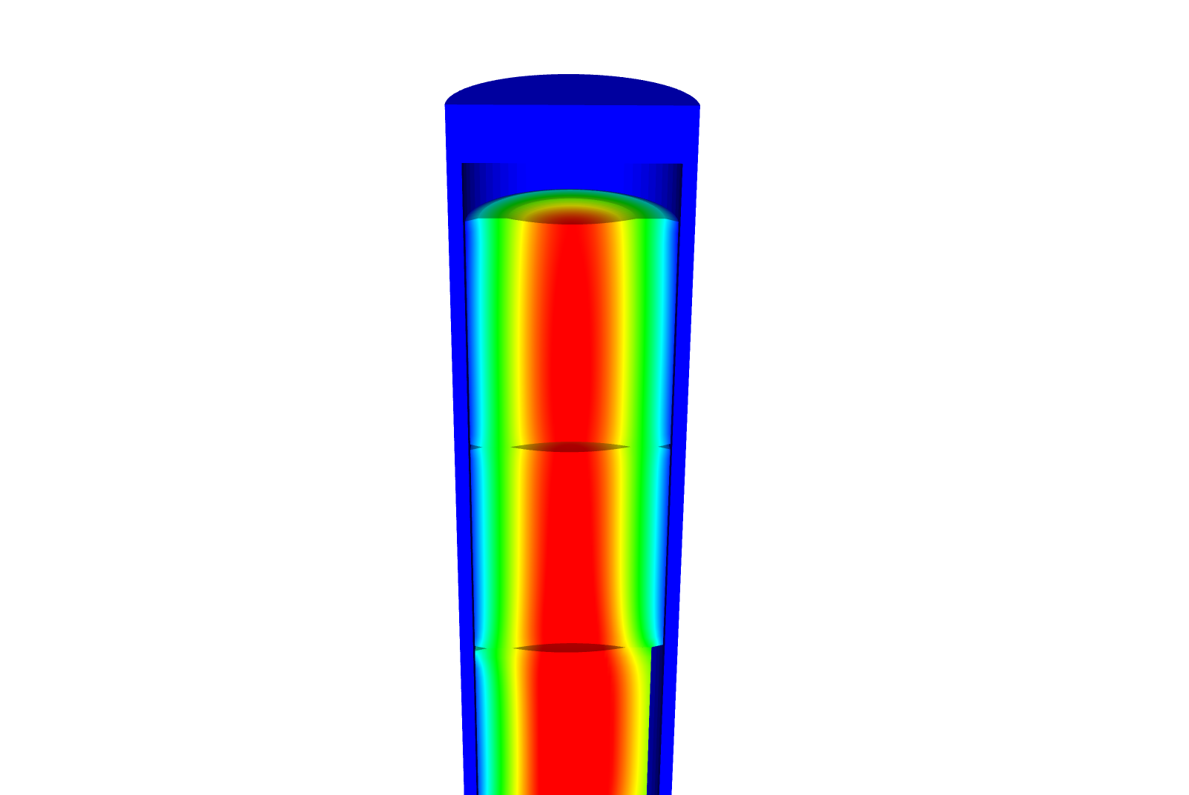
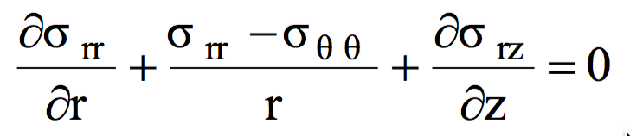
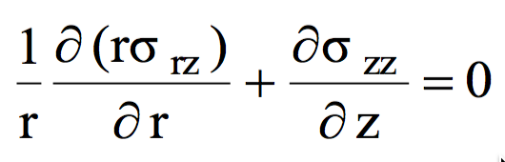
Relating Displacements to Stress
We have been determining the stress due to some internal pressure (or temperature)
Often, the information more readily obtainable are the displacements
Utilizing the previous equations, can develop displacement to stress relationships for our geometry

Slide 10
Assuming problem is axisymmetric

Slide 11
Solve for the stress from the strain
Assume isotropic materials
Can perform matrix multiplication for the calculation of the stress, given the displacements

Slide 12
Further simplify the problem to be 1D
No change in Z:

Slide 13
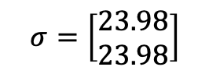
Determine the strain and stress in the pellet for 1D case
Assume the radial displacement in the fuel pellet is u_{r}(r) = 0.05r cm.
What is the strain tensor? At the outer edge:
We are dealing with UO₂, so E = 200 GPa and ν = 0.345
C₁₁ = E (1 – ν)/((1+ν)( 1–2 ν)) = 200*(1–0.345)/(1.345*(1–2*.345)) = 314.2 Gpa
C₁₂ = E ν/((1+ν)( 1–2 ν)) = 200*0.345/(1.345*(1–2*.345)) = 165.5 Gpa
Now we can calculate the stresses
σ_{rr} = 0.05*314.2 + 0.05*165.5 = 23.98 GPa
σ_{θθ} = 0.05*165.5 + 0.05*314.2 = 23.98 GPa
$$σ=\left[\begin{matrix}23.98 \\ 23.98\end{matrix}\right]$$

Slide 14
Example problem
Compute the stress and strain tensors in the center and at the outer edge (r = 0.5 cm) in 1D axisymmetric coordinates in a fuel pellet with u_{r}(r) = r²/5. C₁₁ = 314.2 Gpa, C₁₂ = 165.5 Gpa.
First, calculate the strain tensor
ε_{rr} = u_{r,r} = 2r/5
ε_{θθ} = u_{r}/r = r/5
At the center there is no strain; at the outer edge
To calculate the stress, convert to a strain vector and multiply by elastic constant matrix
The stress in the center is zero
On the outer edge
σ_{rr} = 0.2*314.2 + 0.1*165.5 = 79.4 GPa
σ_{θθ} = 0.1*314.2 + 0.2*165.5 = 64.52 GPa

Slide 15
NUMERICAL THERMO-Mechanics

Slide 16
Now we can solve the temperature and the displacement vector for the full thermomechanical problem
T impacts the value of u through thermal expansion
u impacts the value of T through changes in the thickness of the gap
The value for T evolves with time
The value for u also evolves with time, even though there is not time in its PDE

Slide 17
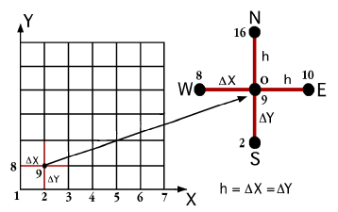
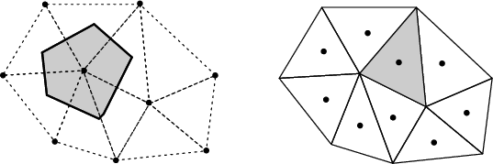

The primary tool for solving all thermomechanics problems is the finite element method
Finite difference
Can solve the heat conduction equation
Can’t easily solve the mechanics equations
Finite Volume
Can solve the heat conduction equation
Can solve the mechanics equations
Eqns derived from fluid dynamics
Finite Element
Can solve the heat conduction equation
Can solve the mechanics equations
Can handle any geometry
Can handle any boundary condition

Slide 18
The 1D thermomechanics problem definition
dT/dr = 0
u_{r} = 0
R_{f}
T_{r} = T_{s}
du_{r}/dr = 0
r
The initial temperature is set to 273 K
We will take 50 time steps of 0.5 s
The full power of Q = 450 begins at time t = 0.
UO₂ material properties are used for both the thermal and mechanics equations

Slide 19
Comparison to analytical theory
If we use a constant thermal conductivity, analytical 1D model matches very well
When k is a function of temperature, there is a difference between the FEM and analytical stress

Slide 20
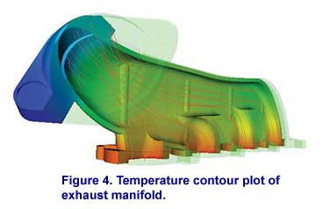
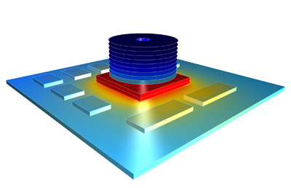

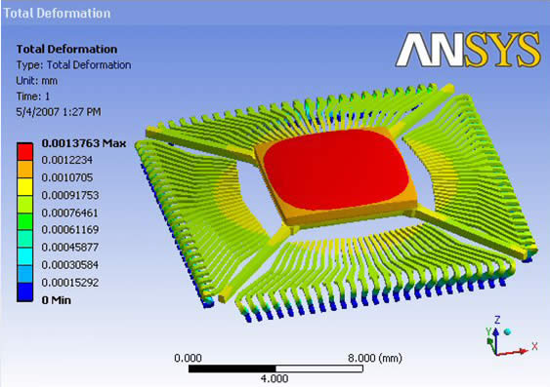

There are various available tools for solving coupled thermomechanical problems with FEM
Commercial tools
ABAQUS
ANSYS
COMSOL
Open source
MOOSE
NRC-based
FRAPCON/FRAPTRAN

Slide 21
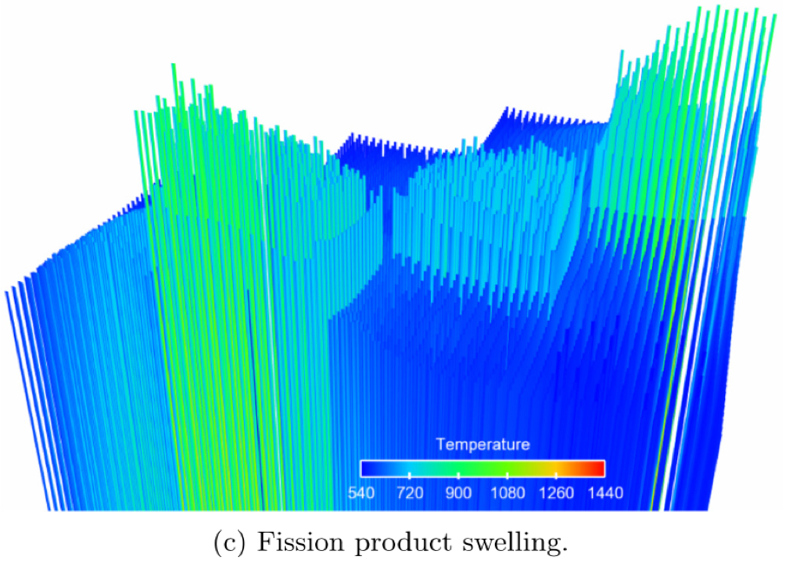

The purpose of a fuel performance code is to simulate and evaluate fuel rod behavior
The first fuel performance codes were developed in the mid seventies
Advanced fuel performance codes are still under development today
KAIST-3A benchmark results, showing displacement of 3432 rods, from Gaston et al. 2014

Slide 22
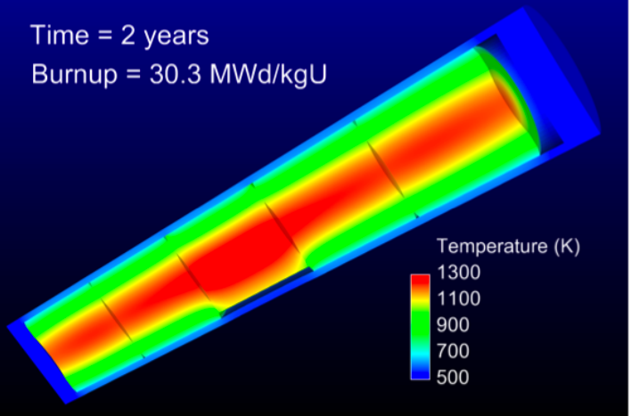
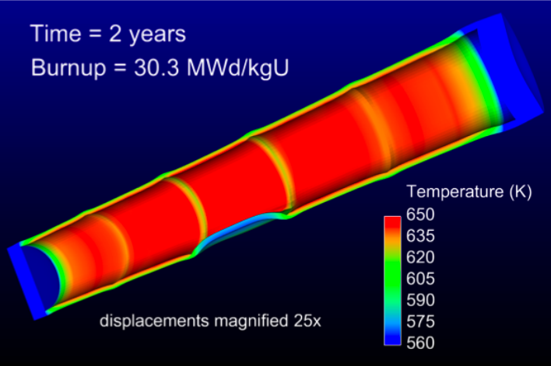
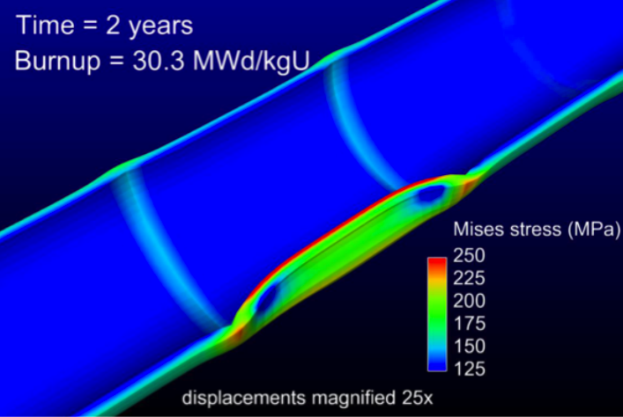
How are fuel performance codes used?
The primary goals are to predict the fuel centerline temperature and the stress in the cladding
Fuel performance codes aren’t focused on predicting power production, but rather to predict safety margins, provide coupling to other codes

Slide 23
A fuel performance code must be able to predict:
Fuel
Temperature profile
Volumetric change
Gap
Gap heat transport
Mechanical interaction between fuel and cladding
Gap pressure
Cladding
Temperature profile
Stress

Slide 24
The primary focus is solving the thermomechanical problem
Fuel
Solved Numerically
Gap
The handling of the gap changes the most between different codes
Solved Numerically or analytically
Cladding
Solved Numerically or analytically
Solved Numerically

Slide 25

Various approaches to model the fuel rod
Transient, full 3D
Transient, 2D axisymmetric with discrete pellets
Computational cost
Accuracy
Transient, 2D axisymmetric with smeared pellets
Transient, multiple 1D slices (1.5D)
Steady, multiple 1D slices (1.5 D)
Transient, 1D
Steady state, 1D (analytical)

Slide 26
Early fuel performance codes were made for either steady state or transient operation
Steady state codes
Leave off the time derivative part of the heat equation
The material properties still evolve with time as a function of burnup
The volumetric changes in the fuel are also a function of burnup
Creep of fuel and cladding change with time
Transient codes
Include the time derivative
Have similar burnup dependent models like steady state codes, but don’t include creep
Have additional models for rapid transients

Slide 27
Start with FRAPCON
Transient, full 3D
Transient, 2D axisymmetric with discrete pellets
Computational cost
Accuracy
Transient, 2D axisymmetric with smeared pellets
Transient, multiple 1D slices (1.5D)
Steady, multiple 1D slices (1.5 D)
Transient, 1D
Steady state, 1D (analytical)

Slide 28
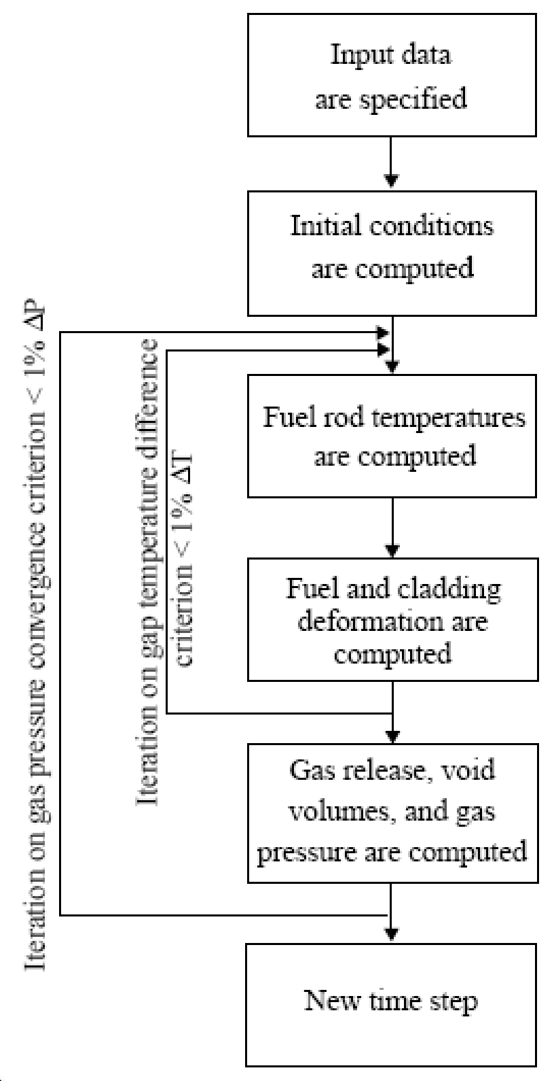
FRAPCON Flow Chart
FRAPCON is the NRC’s steady-state fuel performance code
FRAPCON has the ability to accurately calculate the high-burnup response of light-water reactor fuel rods
FRAPCON iterates to determine fuel rod temperatures, fuel and cladding deformation
This converged data is iterated to produce gas release, void volumes and plenum pressure
Then marches forward in time

Slide 29
FRAPTRAN
Transient, full 3D
Transient, 2D axisymmetric with discrete pellets
Computational cost
Accuracy
Transient, 2D axisymmetric with smeared pellets
Transient, multiple 1D slices (1.5D)
Steady, multiple 1D slices (1.5 D)
Transient, 1D
Steady state, 1D (analytical)

Slide 30
FALCON
Transient, full 3D
Transient, 2D axisymmetric with discrete pellets
Computational cost
Accuracy
Transient, 2D axisymmetric with smeared pellets
Transient, multiple 1D slices (1.5D)
Steady, multiple 1D slices (1.5 D)
Transient, 1D
Steady state, 1D (analytical)

Slide 31
FALCON
FALCON is a 2D fuel performance code developed by EPRI
Development of FALCON started in 1996
The beta version was released in 2003
It was developed by ANATECH for EPRI
FALCON is proprietary, owned by EPRI
It is no longer under active development in the US

Slide 32
FALCON is a 2D transient and steady state code
Fuel
Solved with FEM
Gap
Pressure is calculated using equation of state
Simplified contact model is used for gap closure
Gap heat transfer model is used
Solved with FEM
Cladding
Solved with FEM
Solved with FEM

Slide 33
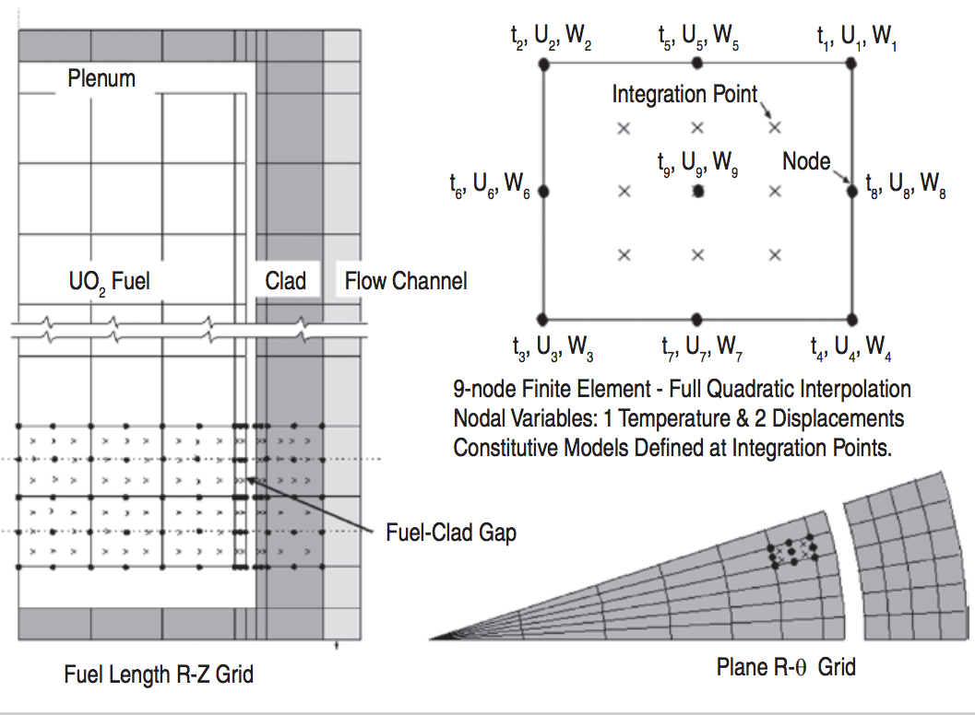
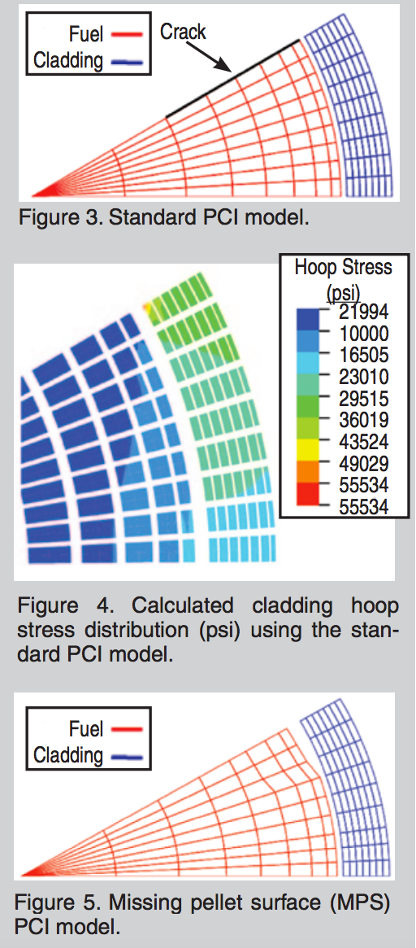
FALCON can predict the fuel performance in axisymmetric RZ space or in Rθ space

Slide 34
BISON
Transient, full 3D
Transient, 2D axisymmetric with discrete pellets
Computational cost
Accuracy
Transient, 2D axisymmetric with smeared pellets
Transient, multiple 1D slices (1.5D)
Steady, multiple 1D slices (1.5 D)
Transient, 1D
Steady state, 1D (analytical)

Slide 35
BISON
The next generation fuel performance code under development in the US
It uses the MOOSE framework
Development was begun in 2008
The first paper using BISON was published in 2009 and the paper summarizing its full capabilities was published in 2012
It was developed at Idaho National Laboratory, with some support by ANATECH
BISON is available for free, but it is export controlled and requires a license agreement be signed

Slide 36
BISON models the fuel behavior ranging from 1D to full 3D and uses FEM
Fuel
Solved with FEM
Gap
Pressure is calculated using equation of state
Fully implemented implicit contact algorithm
Gap heat transfer model is used
Solved with FEM
Cladding
Solved with FEM
Solved with FEM

Slide 37
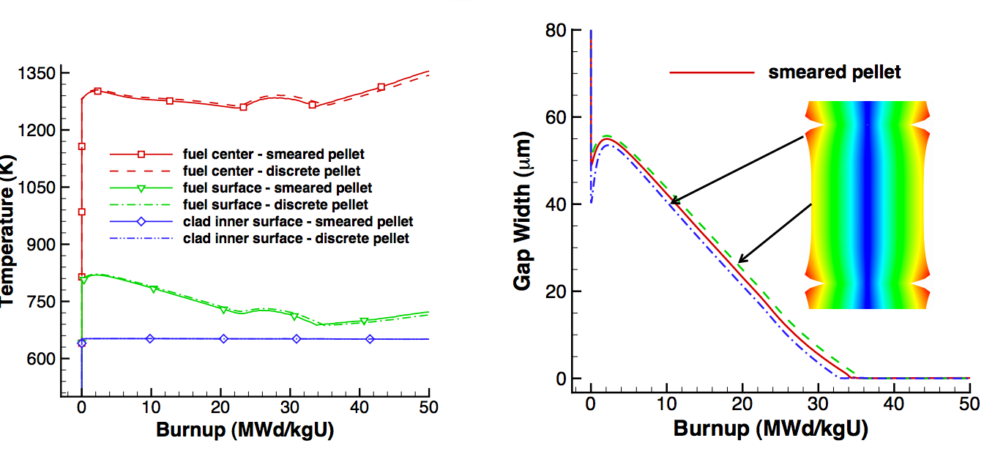
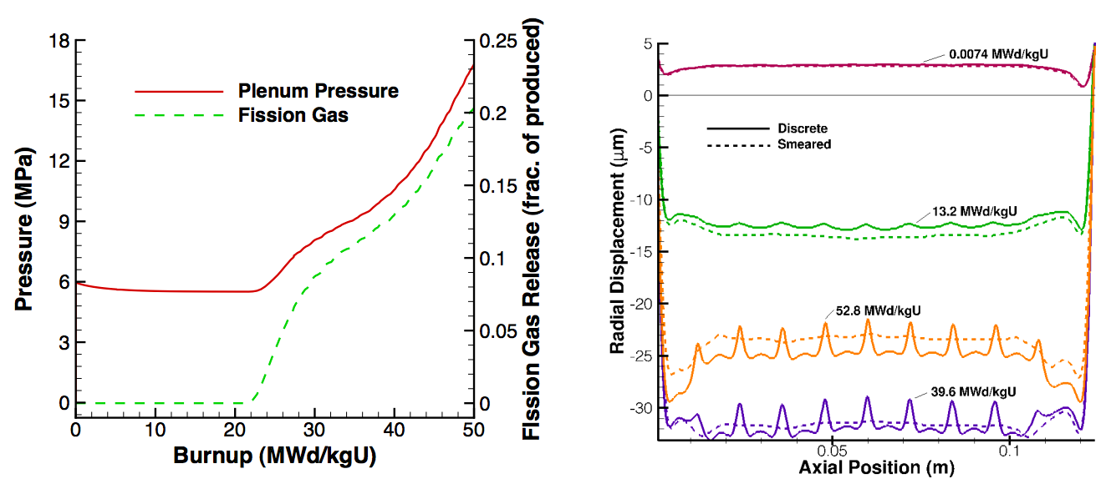
Can handle smeared or discrete pellets, asymmetric pellet geometry and deformation

Slide 38
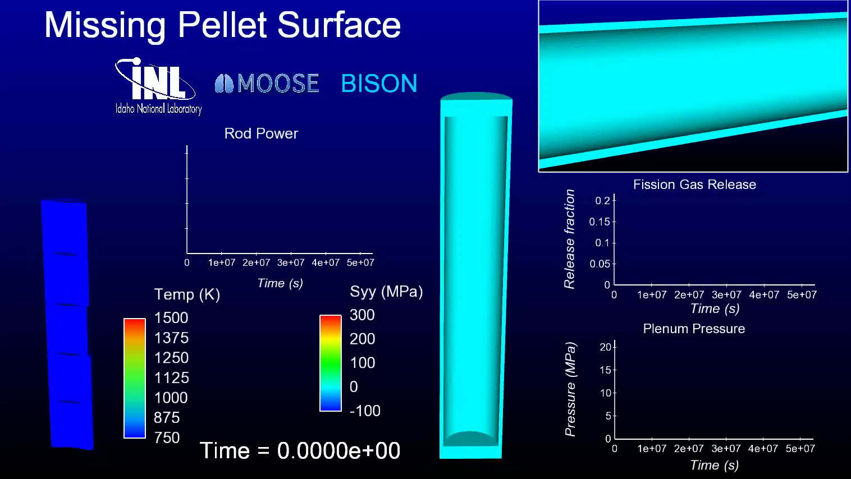
Because of its unique 3D capability, BISON can model truly 3D fuel performance problems

Slide 39
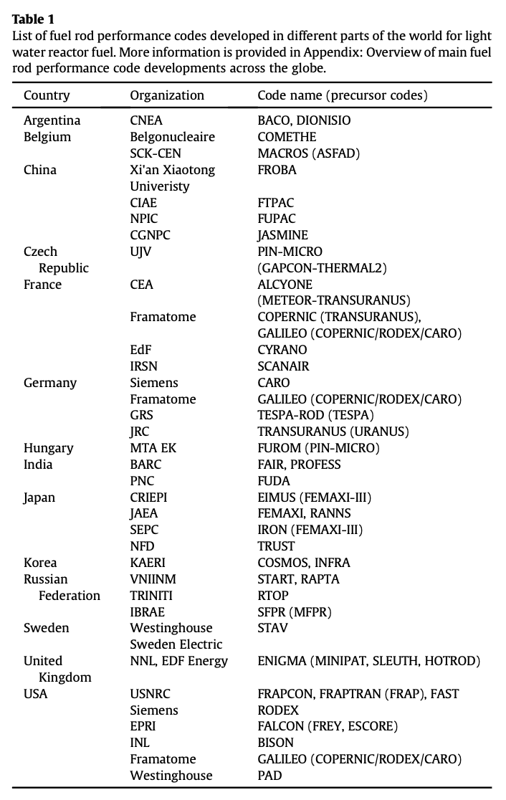
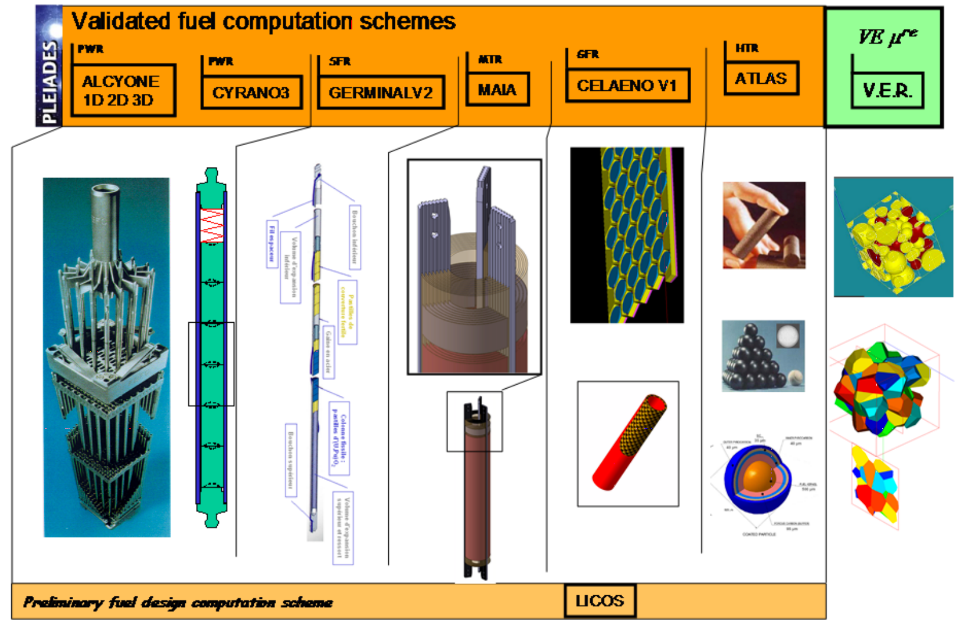
Other countries have other fuel performance codes
http://www.materials.cea.fr/en/PDF/PLEIADES-Platform.pdf

Slide 40
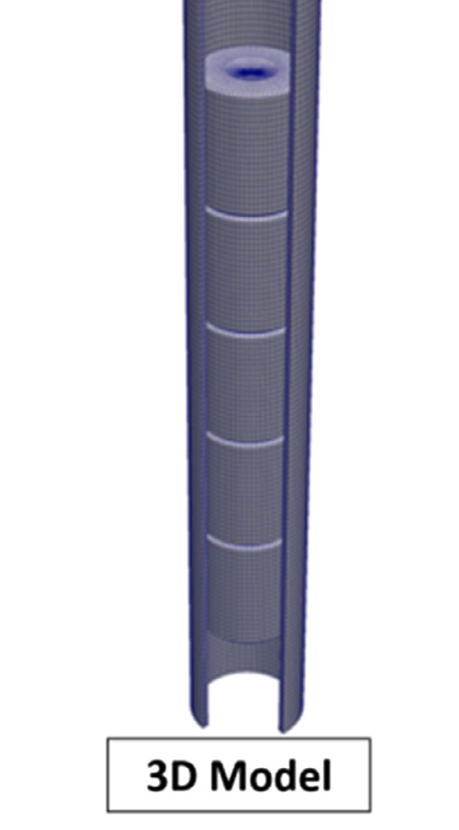
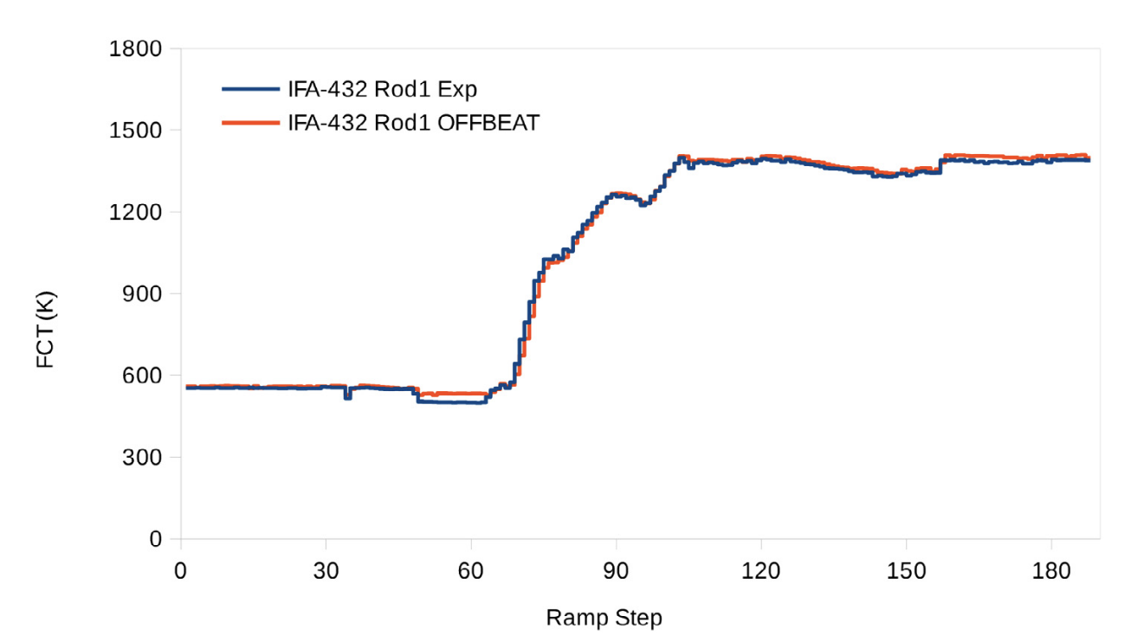
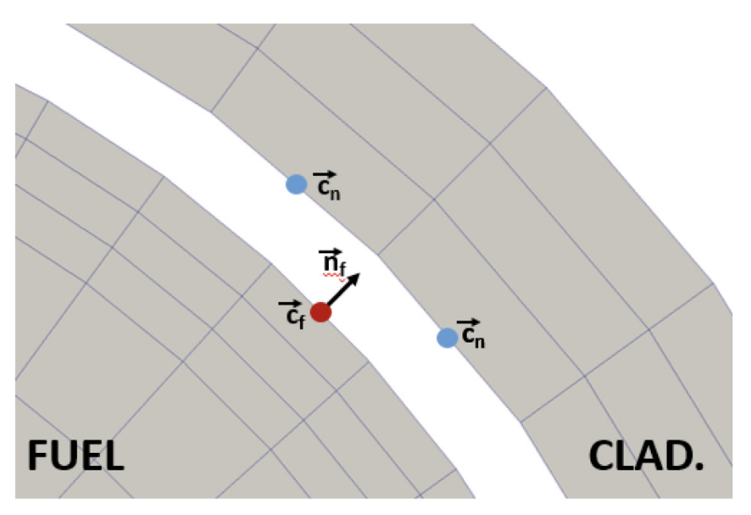
OFFBEAT – new tool
The OpenFOAM Fuel BEhavior Analysis Tool (OFFBEAT) is a multi-dimensional fuel performance code developed in Switzerland
The code can be used both for studying complex 2D or 3D local effects and for more traditional 1.5D base irradiation analyses
OFFBEAT is based on the open-source C++ library OpenFOAM, thus the governing equations are discretized with modern finite volume techniques

Slide 41
Summary
Gap size changes due to thermal expansion
Often have displacements instead of strains, and can solve for stress via displacements
Fuel performance codes are focused on predicting the center temperature of the pellet and the stress in the cladding
All fuel performance codes
Numerically model the temperature in the fuel
Numerically model the stress in the cladding
And consider gap pressure, closure, and heat transfer in some way
The primary US codes are
FRAPCON – Steady state 1.5D, uses finite difference
FRAPTRAN – Transient 1.5D, uses finite difference
FALCON – Steady or transient 2D, uses finite element
BISON – Steady or transient, 1D – 3D, uses finite element

